Slide 1
Milestone 4
Ryan Woodward – V00857268
Italo Borrelli – V00884840
Devlin Wyatt - V00892740

Slide 2
Milestone 4 – Part 1
Jonathan’s Updated Use Case

Slide 3
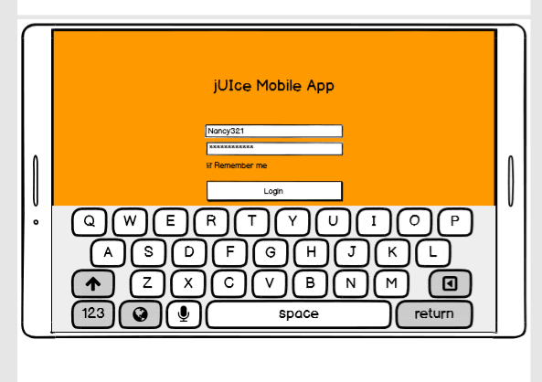
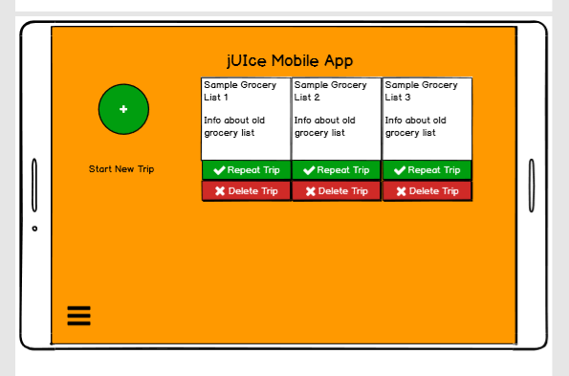
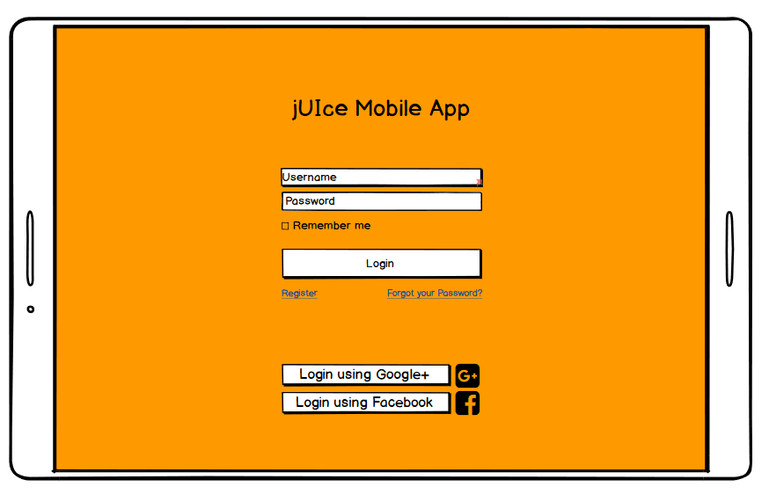
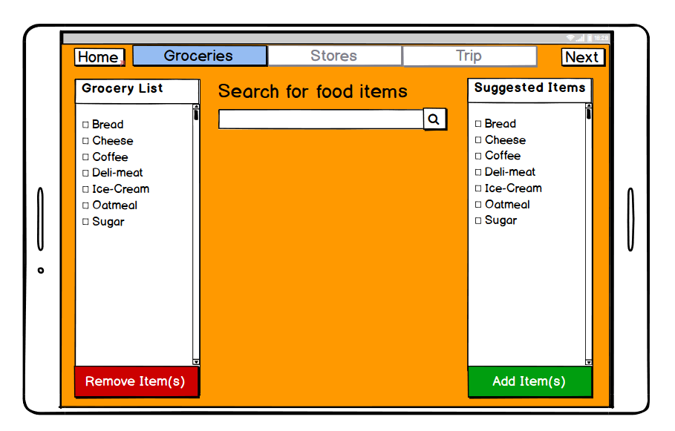
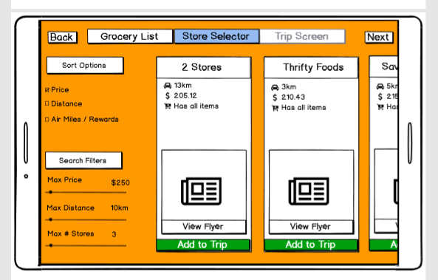
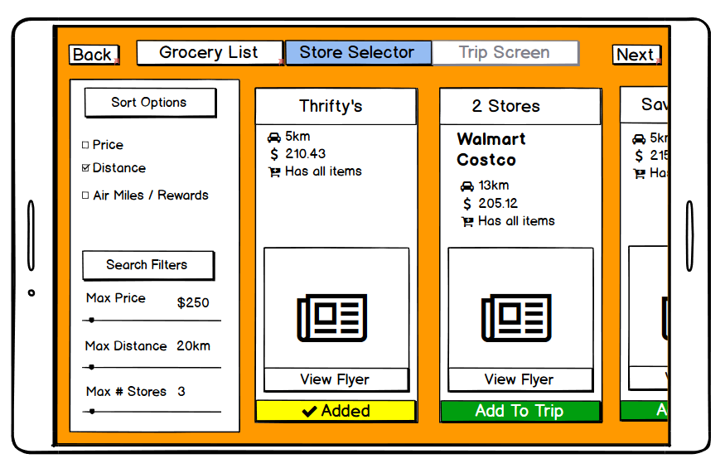
Jonathan wants to start a new grocery trips so he opens up the app and the system responds by bringing him to the login screen
He wants to login with a username and password. The system responds by bringing up a keyboard to allow him to type in his information
Jonathan types in his information for both his username and his password and then clicks on login. The system accepts his information and responds by bringing him to the home screen
Jonathan wants use an old grocery list so he clicks on repeat trip under grocery list 1 1. The system responds by loading his old grocery list and bringing him to the grocery list page.
Having his grocery list already complete Jonathan clicks on next to go to the store selector. The system brings him to the store selector screen.
Jonathan wants to change the maximum distance to 20km. The system repsonds by eliminating all options over 15km.

Slide 4
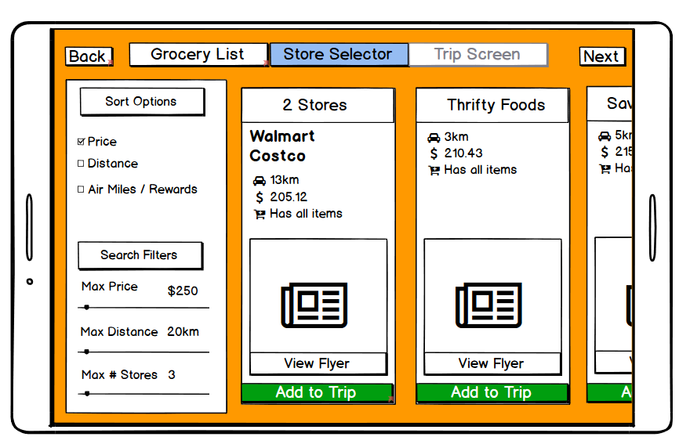
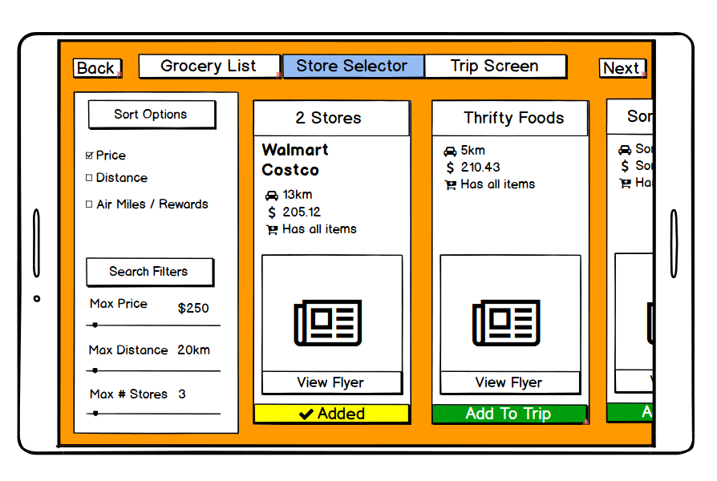
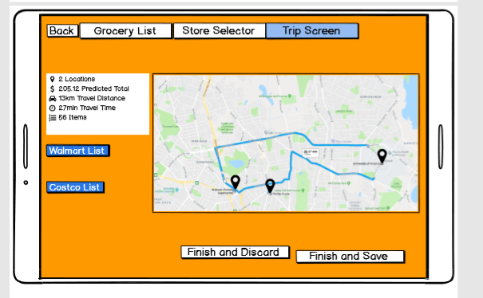
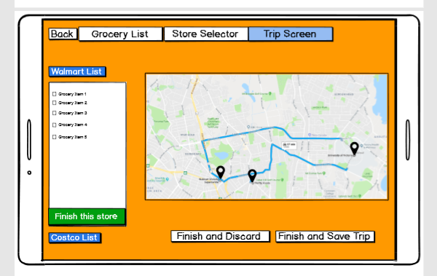
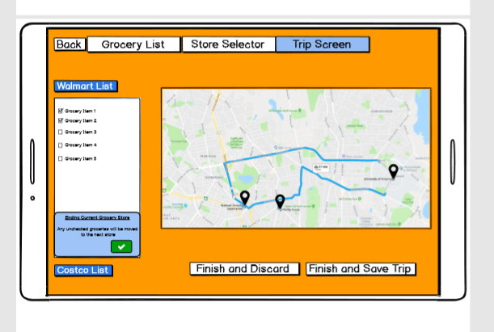
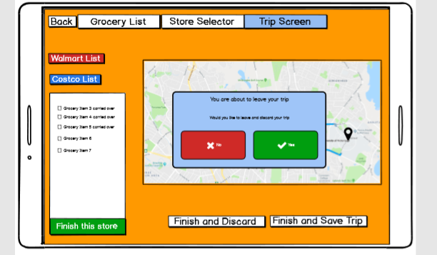
Jonathan wants to sort the stores by the cheapest option available. He taps on price under the sort filters tab and the system responds by offering choices sort by ascending price.
Jonathan wants to select the new cheapest trip option. He notices that the system is suggesting that he goes to 2 stores in order to have the lowest bill. He clicks on add to trip. The system responds by changing the button color and allowing him to go to the trip screen.
Jonathan clicks on next and the system responds by bringing him to his current trip screen.
Jonathan now clicks on the Walmart list to see which grocery options are suggested. The system responds by opening up the Walmart list.
Jonathan clicks off each grocery item and the system responds by marking off each grocery item that Jonathan has pressed with a checkmark. He then clicks that the finish store button
The system prompts Jonathan and he accepts items will be moved to the next store. He decides he would like to finish and discard his grocery list. The system responds with an alert.

Slide 5
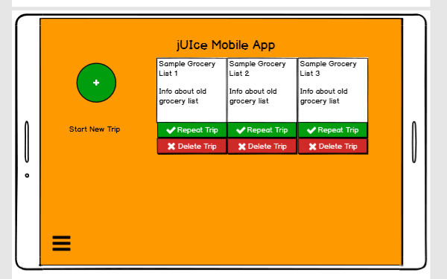
Jonathan accepts that he is finished with his trip and would like to return to the main screen. The system responds by bringing him back to the main screen.
We decided to change the keyboard from only taking up a part of the screen to taking of the entire width of the bottom of the screen. This change was decided on due to the feedback given from in lab stating that the keyboard felt too cramped.
The main screen has been changed to save grocery lists rather than trips. Upon feedback it was determined that using full trips as opposed to lists was counter intuitive and people felt like they would search for the same groceries again rather than the exact same trip. Therefore Jonathan will now load up an old grocery trip and be transferred to the grocery list screen with his old grocery list loaded.
We decided to add values to the search sliders to give the user a better sense of feedback when they were changing the values. Also we determined in order to make things easier it would just be considered a maximum value slider.
As opposed to selecting multiples stores in the store selector screen it was determined that all the stores would be combined into one pane to make the usability easier for the user. This way the user can simply push one button to select the best trip as opposed to pushing multiple buttons in order get to the trip screen.
It was determined that when there were multiple stores in the trip screen, and if the user had grocery items remaining when the finish store button was selected they should be moved to the next store. The system would prompt the user asking them if they wished to do this. This was determined to be a simpler solution if an item was sold out at the first store, or if the user simply preferred the item at the second store.

Slide 6
Milestone 4 – Part 1
Kimberly’s Updated use case

Slide 7
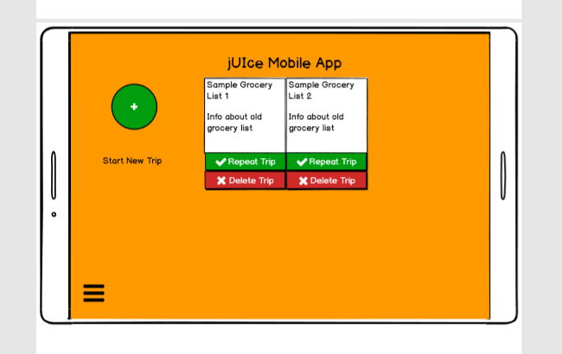
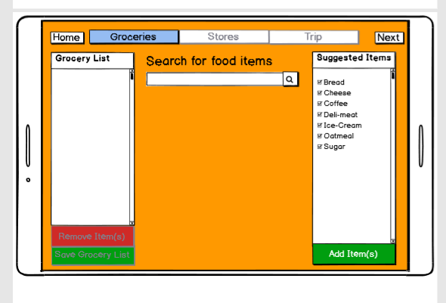
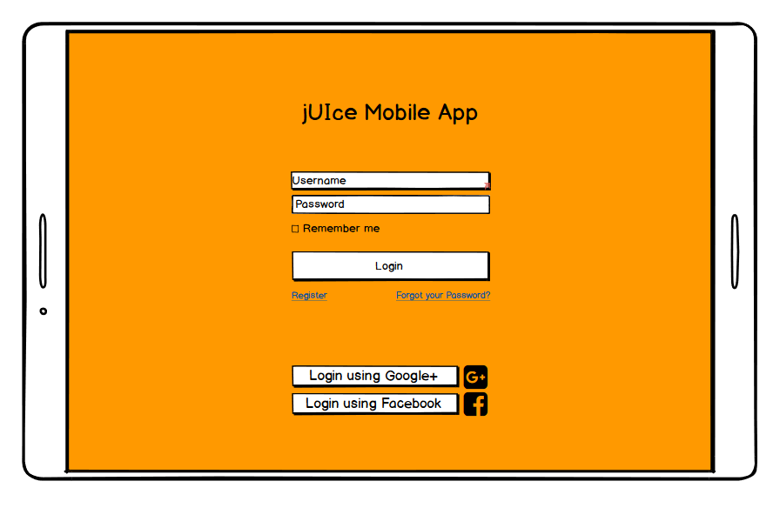
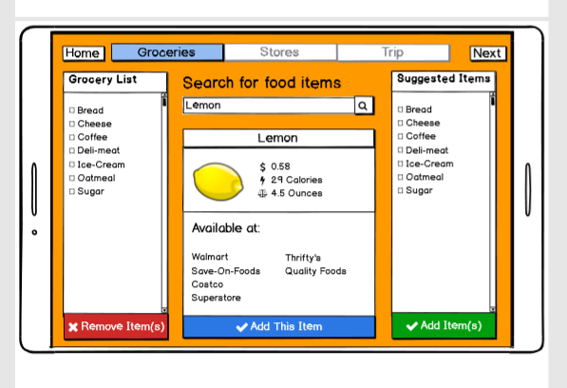
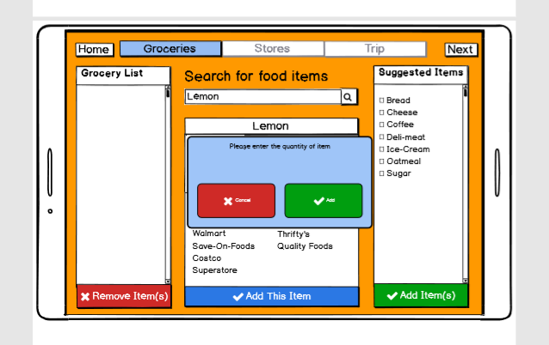
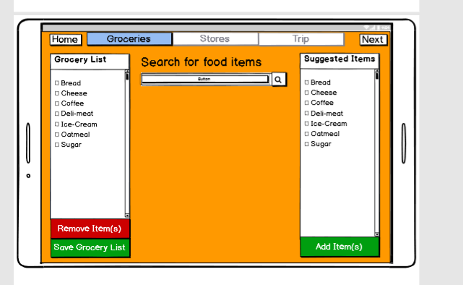
The system responds by connecting Kimberly to her account and bringing her to the jUIce home page
Kimberly wants to start a new trip so she click on the start a new trip button. The system responds by sending her to the grocery list page so she can start entering new items.
Kimberly wants to start up a new grocery trip. The system responds with a login screen. Kimberly pushes the login with the Google+ button
Kimberly selects items from the suggested items list. The system responds by placing a check mark beside each of the items that she has selected. She then pushes the add item button to add those items to her grocery list.
Kimberly wants to search for additional food items to add to the list so she types in the search bar to look for items. She searches for lemons and the system responds by bringing up information about lemons
Kimberly selects add this item in order to add the lemon to her grocery list. The system responds by asking a quantity of the item that she wishes to add

Slide 8
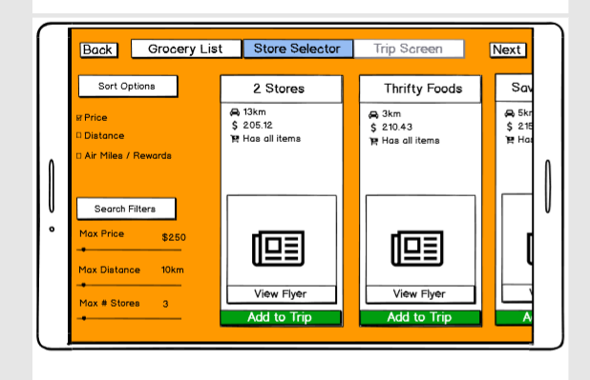
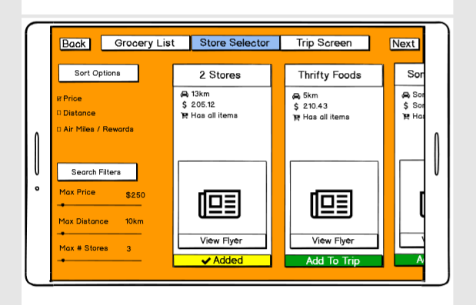
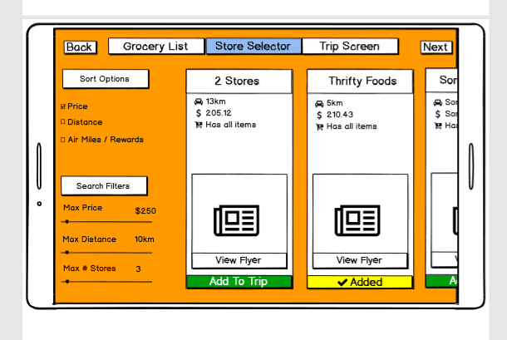
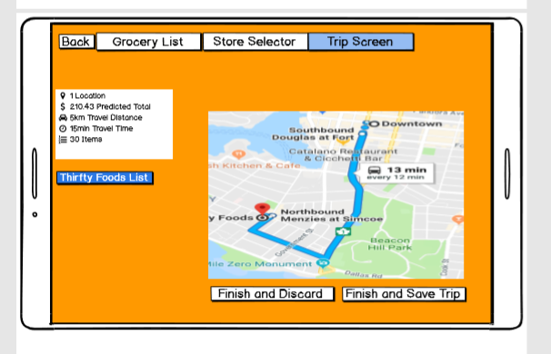
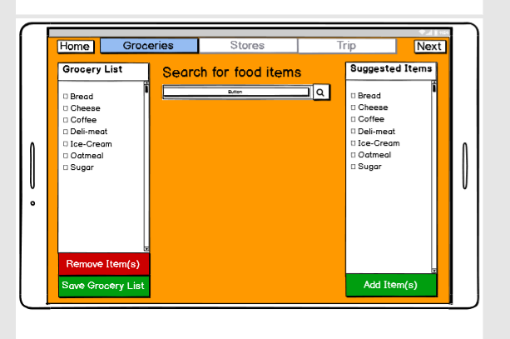
Kimberly wants to now see which stores are recommended to her so she clicks on next to go to the next step. The system responds by bring her to the store screen.
Kimberly wants to sort the recommended stores by the lowest price. She taps the price option under sort options. The system responds by sorting the stores by prices for lowest to highest from left to right
Kimberly immediately clicks on the first option which recommends 2 stores to go on her trip. The system responds by changing the color of the icon, giving her a signifier as feedback, and adding the trip.
Kimberly decides that she would prefer to only go to one store. So she clicks on add to trip underneath thrifty foods. The system responds by providing feedback signifying Thrifty Foods is now active. It also removes the 2 stores from being a selected trip
Kimberly selects “Next”. The system saves her choices and sends her to the “Trip page.”
Kimberly reviews her order but wants to add another item to her list. So she selects “grocery list” from the menu bar. The system takes her to her grocery list.

Slide 9
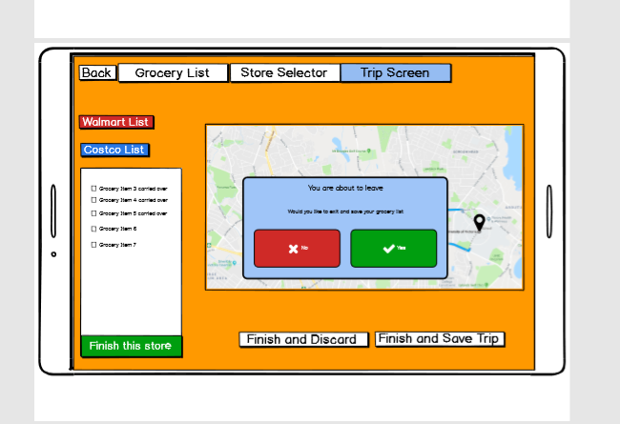
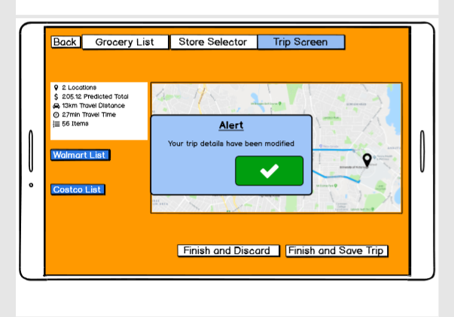
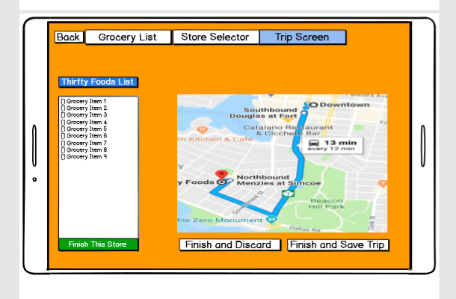
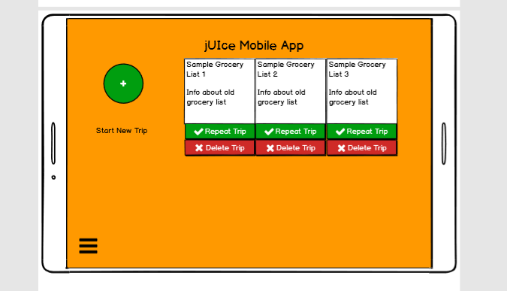
Kimberly adds another item then presses the “Trip” button. She notices that it is no longer greyed out as she has already followed the steps to create a trip. The system loads the trip page with the new information.
When Kimberley to the trip page following the changes an alert lets her know that her trip has been modified. She recognizes this and clicks the checkmark to hide the alert box
Kimberly clicks off her selected grocery items and decides to finish her trip while items are still not selected
The system responds by alerting Kimberly that she still has items remaining and asks if she wants to save them. She decides she still wants to leave and clicks on the green yes box. The system responds by saving the list and returning to the main screen, with a new list added
It was determined in Kimberly’s use case that we needed to add a quantity button in case she would like to add more than one item at a time when she searches.
During group feedback it was decided that only one trip should be added at once. As a result during Kimberly’s use case she originally selects the first option and then changes her mind and selects the second option, being Thrifty Foods. As a result the system will now deselect the first trip option and only allow one trip to be moved into the trip screen. This was changed as a result to reduce user confusion when attempting to add trips. If there were too many trips being added it could severely dilute the straightforwardness of the design. By only allowing the user to select one option at a time it prevents them from becoming overwhelmed, and also reduces the possible need for them to undo some of their actions if they wanted to change around the number of stores. Also, if multiple stores were selected the amount of information changing on the screen for determining the best possible grocery list from remaining items could confuse the user.

Slide 10
Milestone 4 – Part 2

Slide 11
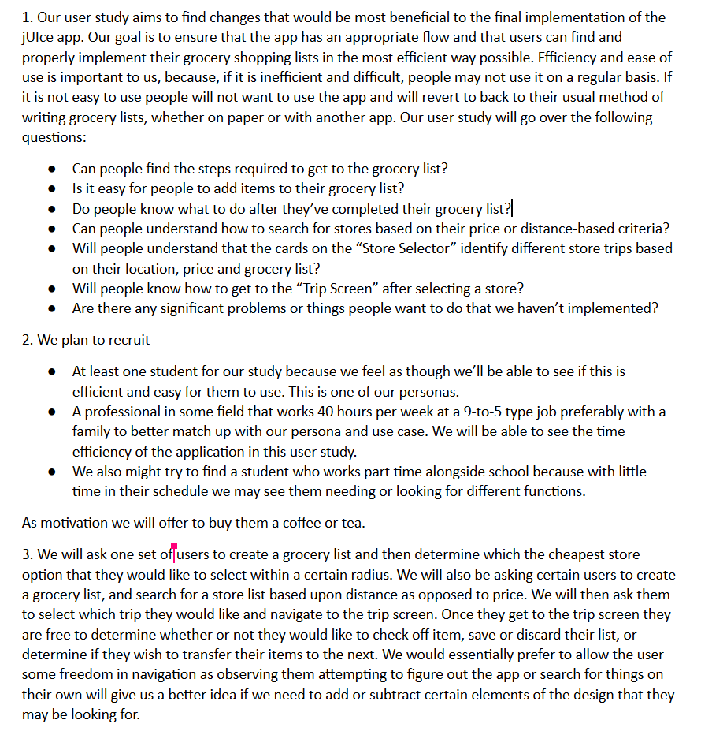

Slide 12
